Slide 2
Norms for our Virtual Workshop
Smiling Faces (Have your video on!)
Be sure to mute your device.
Avoid multitasking!
Take notes!
Use chat box for questions!
Tips for Navigating Zoom

Slide 4
What is financial aid?
Student Financial aid is money provided by federal or state governments or other entities, such as a college or private organization to help students pay for the cost of college attendance.

Slide 5
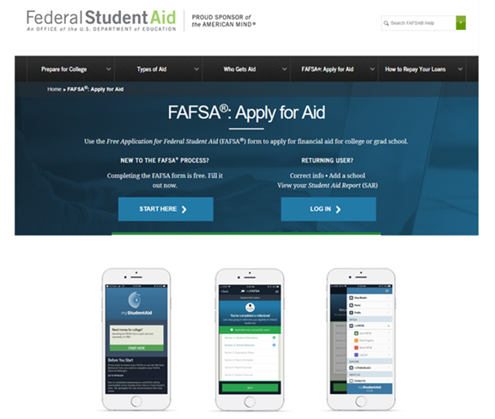

Slide 6
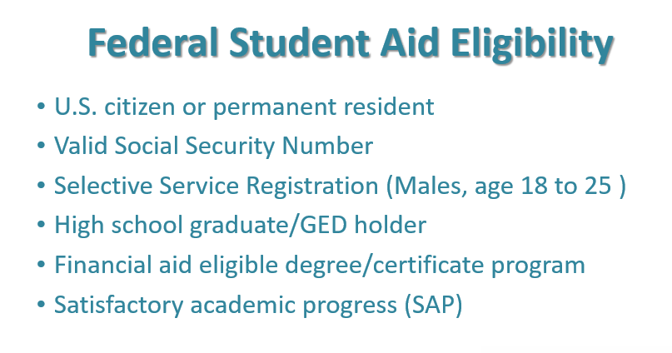

Slide 7
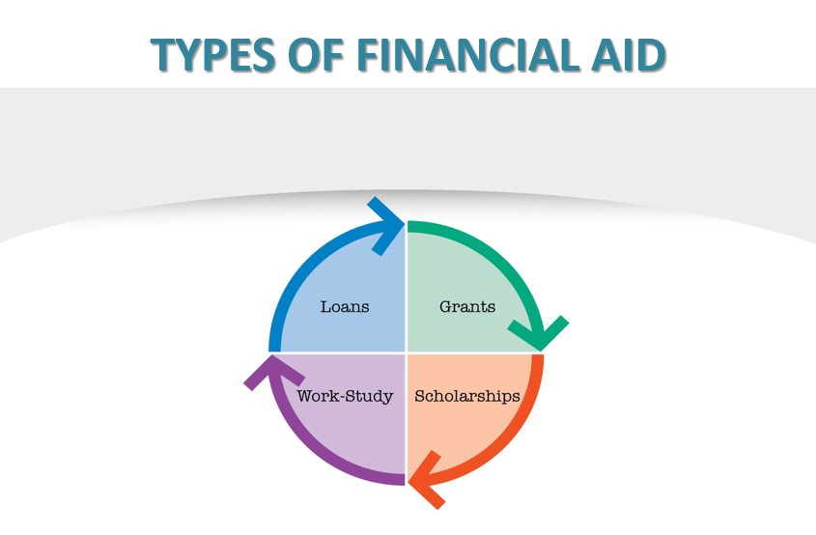

Slide 8
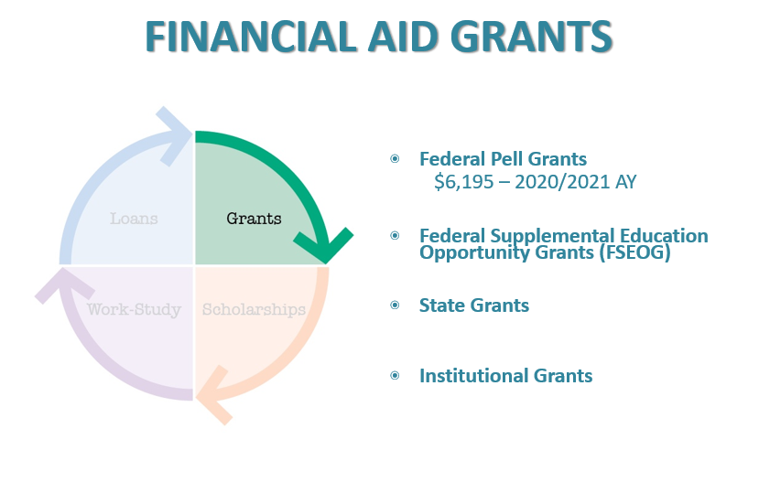

Slide 9
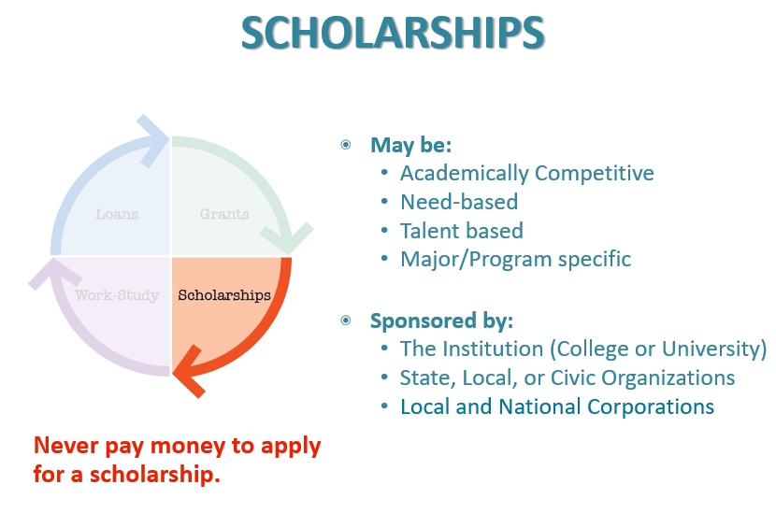

Slide 12
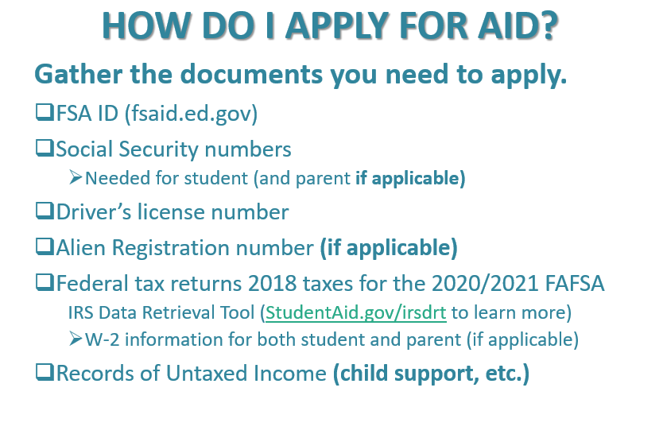

Slide 13
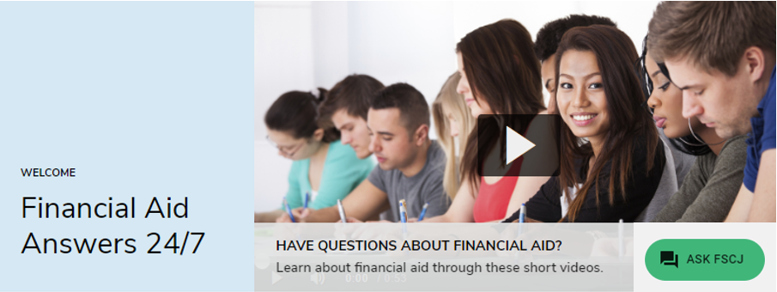
Financial Aid TV
https://fscj.financialaidtv.com/

Slide 15
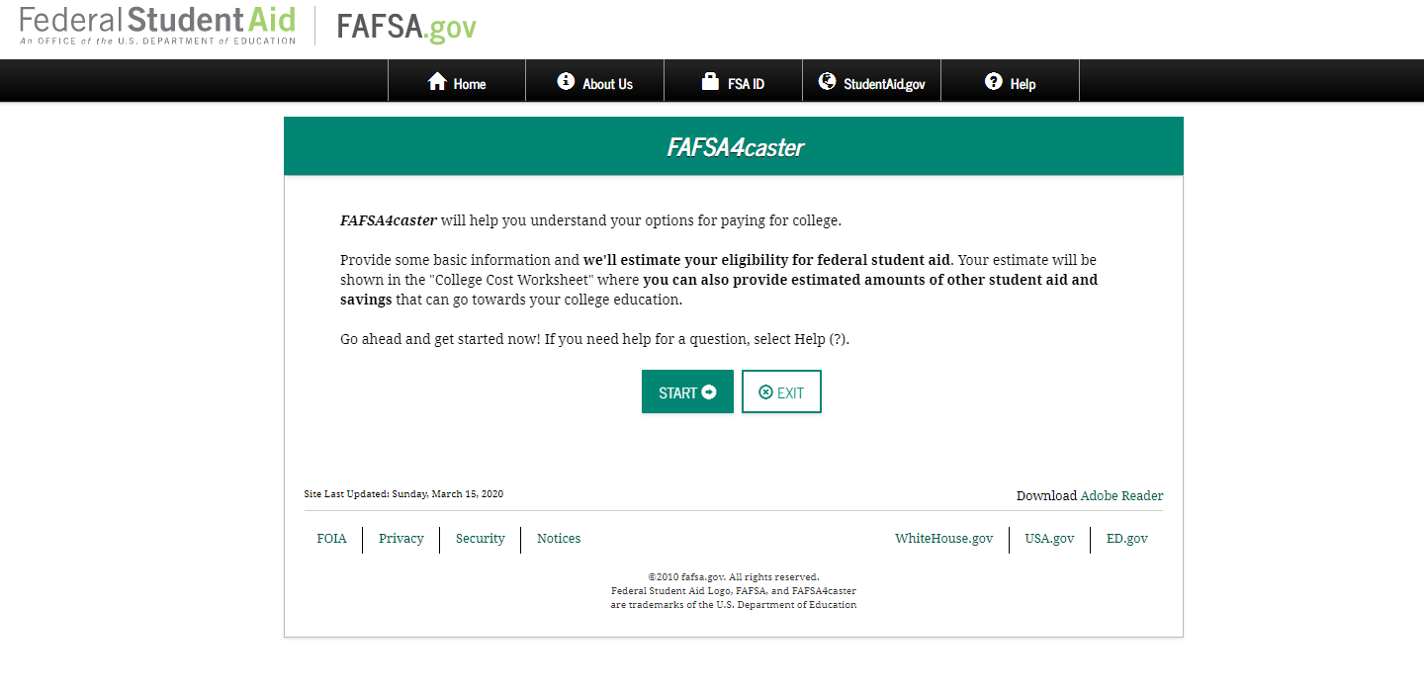
FAFSA4Caster
https://studentaid.gov/understand-aid/estimate

Slide 16
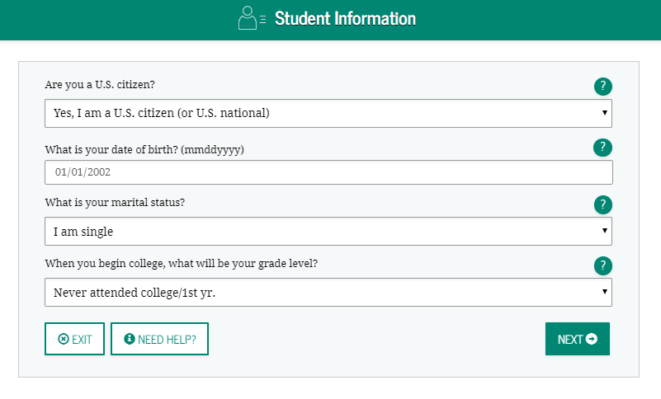
FAFSA4Caster

Slide 17
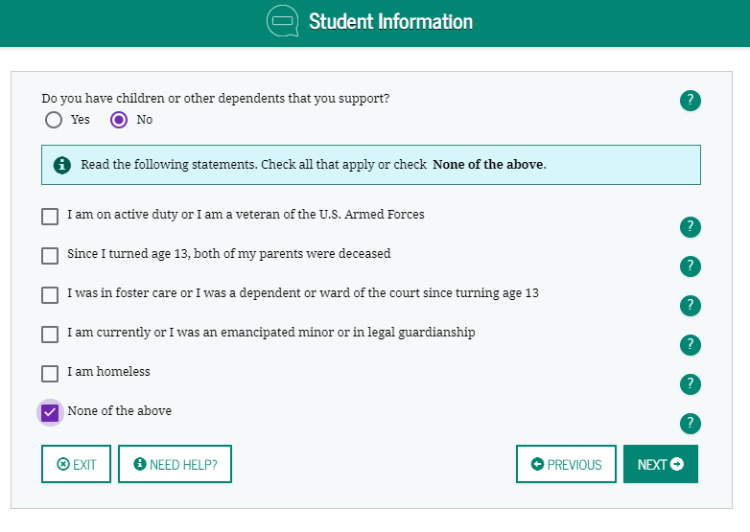
FAFSA4Caster

Slide 18
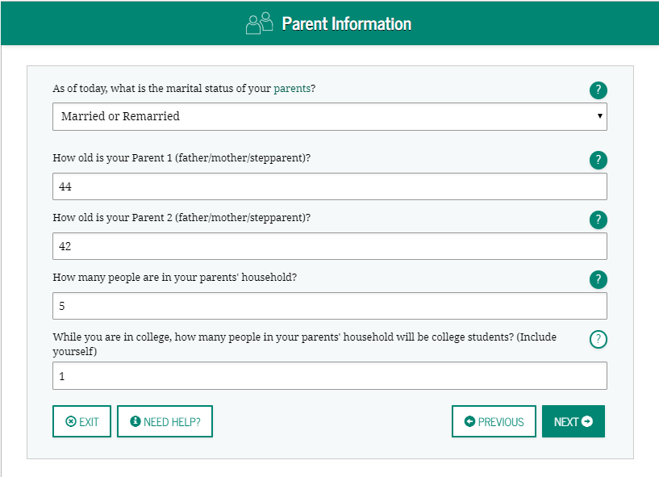
FAFSA4Caster

Slide 19
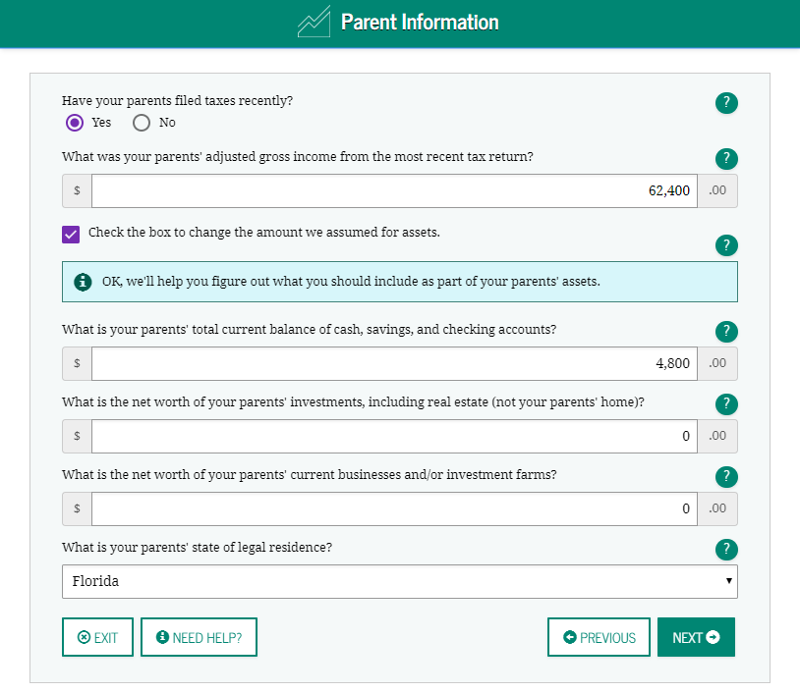
FAFSA4Caster

Slide 20
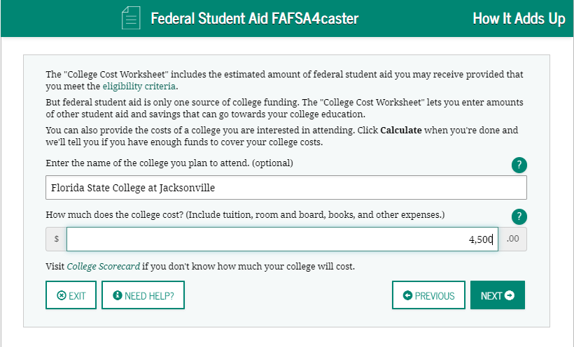
FAFSA4Caster

Slide 21
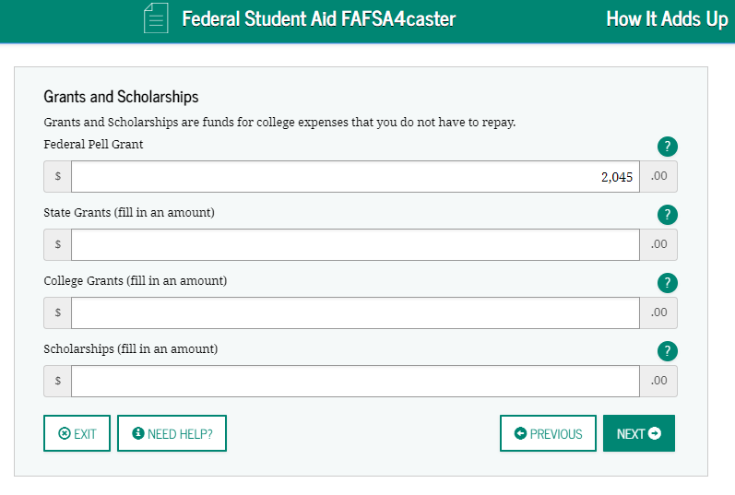
FAFSA4Caster

Slide 22
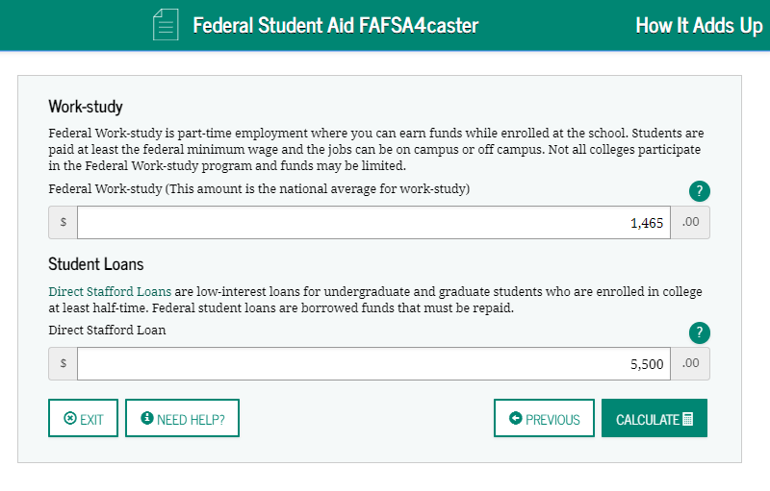
FAFSA4Caster

Slide 23
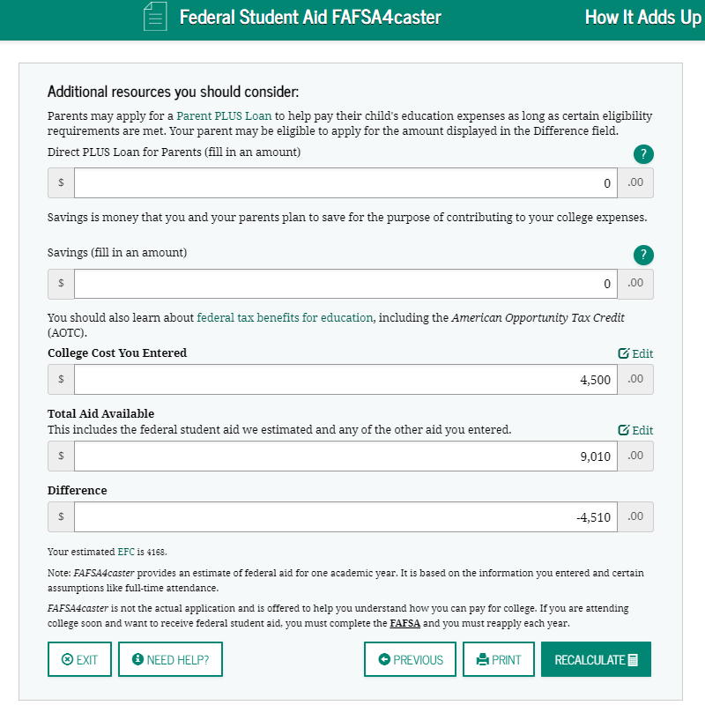
FAFSA4Caster

Slide 24
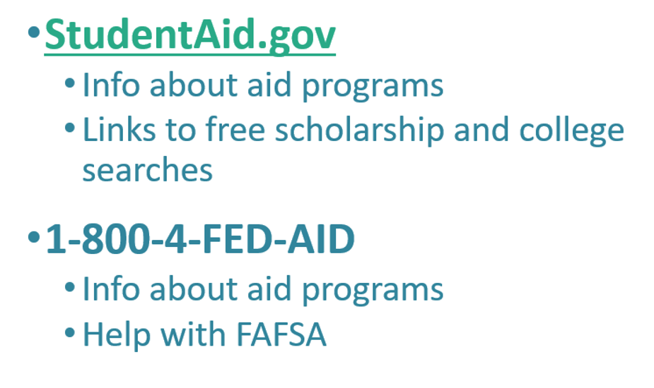
Additional Resources

Slide 26
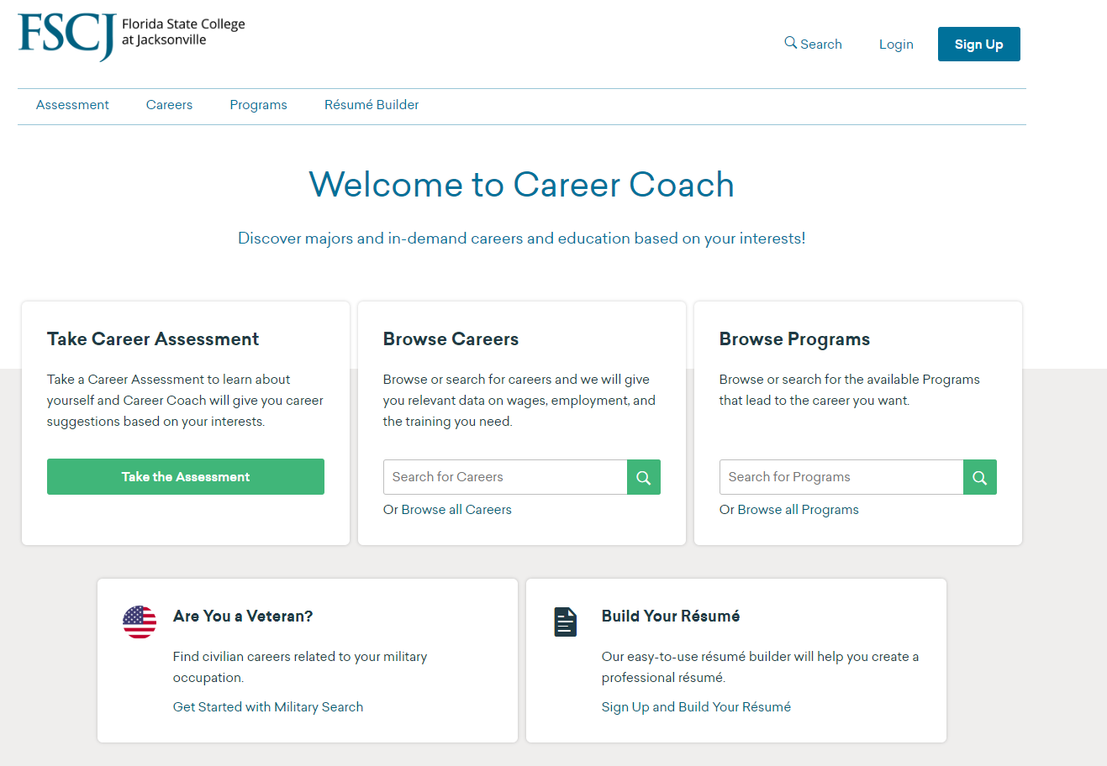
Career Coach
https://fscj.emsicc.com

Slide 28
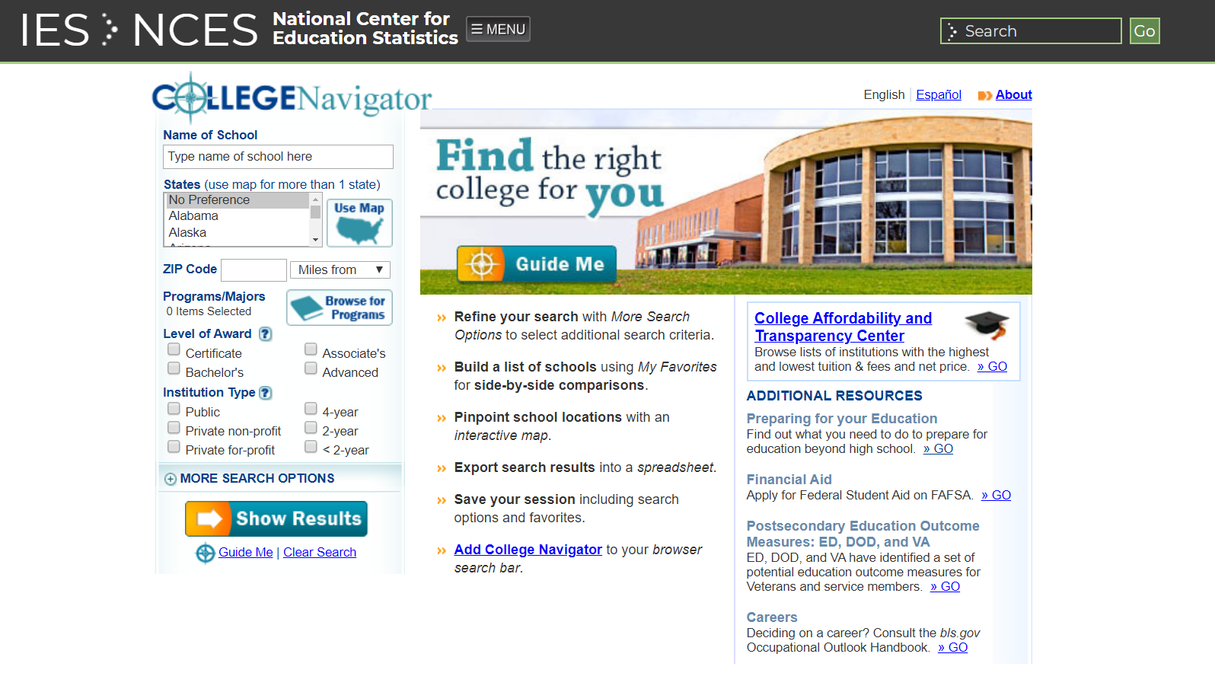
College Navigator
https://nces.ed.gov/collegenavigator/

Slide 30
Form Your Future Survey
& Scholarship Drawing
https://gck.fm/kabqj

